Slide 1
ENERGY CYCLE OVERVIEW
____________________
ONUNWOR EXCELLENCE
DATA / ENERGY ANALYST
____________________

Slide 2
CONTENTS
1
2
3
OVERVIEW
OBJECTIVE
ANALYSIS
4
5
INSIGHTS
CHALLENGES &
RECOMMENDATIONS

Slide 3
1.
OVERVIEW
This article analyzes the consumption and production of energy on a large scale level TWh (Trillion mega watt) across countries in different continents. Operation dates to be between 2020-2024 given different energy sources and CO2 emission levels, renewable shares (%) Etc.

Slide 4
2.
OBJECTIVE
The energy sector which undoubtedly is an evolving sector,
requires proper documentation in inputs and outputs that gives room for flexibility as regards production efficiency and regulated CO2 Emissions .

Slide 5
OBJECTIVE
This analysis uncovers factual patterns to support data driven decision making for improved energy
planning, sustainability, and policy formulation within the targeted
countries.
______________________________________________________________
Identifies overall trends which includes,
Compares consumption and production efficiency
Peak Consumption and Production Months and Years
C02 Emission values
(indicating Significant CO2 emission values as CO2 Pollution)
Countries prioritizing renewables
Energy Sources

Slide 6
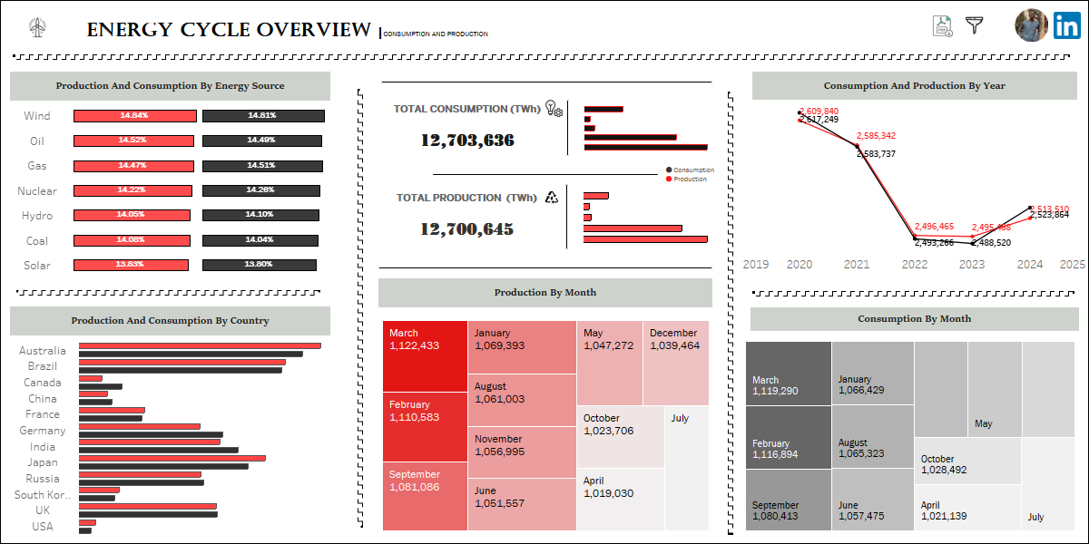
3. ANALYSIS

Slide 7
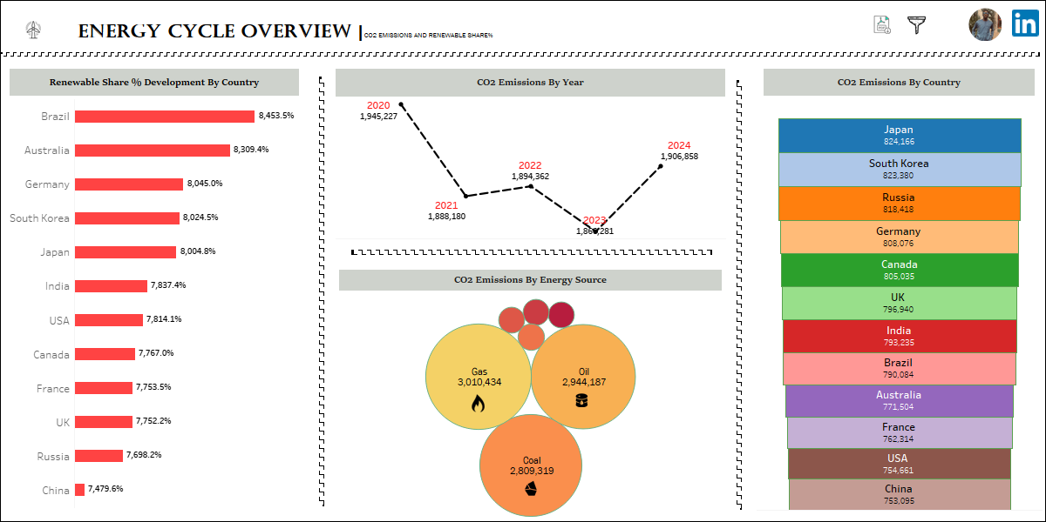
DASHBOARD

Slide 8
DASHBOARD OVERVIEW
A Tableau (Visualization) Dashboard was built as regards the data set. It features
2 KPIs (Key Performance Indicators)
Total Consumption - 12,703,636 TWh
Total Production - 12,700,645 TWh
These values indicate that in the operation span of 4 Years, Total Consumption was greater than Total Production
Indicating a ‘SHORTFALL/DEFECIT’. Which is where consumption is more than production, the opposite of that would be a “SURPLUS”

Slide 9
4. INSIGHTS
The dashboard infographics were divided into 2 parts
Consumption & Production
Renewables, CO2 Emissions
CONSUMPTION & PRODUCTION
Explains the efficiency and balance ratio of production to consumption ratio
across given Geographical Areas, Energy Sources, Operation Years, Months
BY YEAR:
Year | Production TWh | Consumption TWh | Output
2020 | 2,609,840 | 2,617,249 | DEFICIT
2021 | 2,585,342 | 2,583,737 | SURPLUS
2022 | 2,496,465 | 2,493,266 | SURPLUS
2023 | 2,495,488 | 2,488,520 | SURPLUS
2024 | 2,513,510 | 2,523,864 | DEFICIT

Slide 10
4. INSIGHTS
The Year 2020 was the highest production and consumption Year with Production
Values as 2,609,840TWh and Consumption Values as 2,617,249TWh
The Year 2020 and 2024 recorded a “Surplus” while 2021 through 2023 recorded a
“Deficit”
BY ENERGY SOURCES:
With Wind, Solar, Oil, Nuclear, Coal, Hydro, Gas as stated sources,
HIGHEST PRODUCING AND CONSUMING ENERGY SOURCE
WIND with Consumption values 1,881,223 TWh and
Production values 1,884,446 TWh
LOWEST PRODUCING AND CONSUMING ENERGY SOURCE
SOLAR with Consumption values 1,753,005 TWh and
Production values 1,756,296 TWh

Slide 11
4. INSIGHTS
BY COUNTRY:
Given countries are:
Australia, Brazil, China, France,
Germany, India, Japan, Russia,
South Korea, United Kingdom, USA
HIGHEST PRODUCING AND CONSUMING COUNTRY:
AUSTRALIA with Consumption values 1,100,736 TWh and
Production values 1,094,769 TWh
LOWEST PRODUCING AND CONSUMING COUNTRY:
USA with Consumption values 1,026,477 TWh and
Production values 1,027,914 TWh

Slide 12
4. INSIGHTS
BY MONTHS:
HIGHEST PRODUCING AND CONSUMING MONTH:
MARCH with Consumption values 1,119,290 TWh and
Production values 1,122,433 TWh
LOWEST PRODUCING AND CONSUMING MONTH:
JULY with Consumption values 1,015,434 TWh and
Production values 1,018,123 TWh

Slide 13
4. INSIGHTS
RENEWABLES
RENEWABLE SHARE % DEVELOPMENT BY COUNTRY
(Countries tilting towards renewable energy):
HIGHEST RENEWABLE SHARE% BY MONTH:
BRAZIL with 8,253.5%
LOWEST RENEWABLE SHARE% BY MONTH:
CHINA with 7,479.6%
This means that Brazil is migrating the fastest towards renewable energy sources, therefore
they enjoy less CO2 Emissions and pollutions.

Slide 14
4. INSIGHTS
CO2 EMISSIONS
BY ENERGY SOURCE (Million Tonnes):
TOP 3
GAS with 3,010,434Mt
OIL with 2,944,187Mt
COAL with 2,809,319Mt
BY YEAR:
Highest Emissions: 2020 with 1,945,227Mt
Lowest Emissions: 2022 with 1,866,281Mt
BY COUNTRY:
Highest Emissions: JAPAN with 824,166Mt
Lowest Emissions: CHINA with 753,095Mt

Slide 15
CHALLENGES & RECOMMENDATIONS
5.

Slide 16
5. CHALLENGES / RECOMMENDATIONS
CHALLENGE – CONSUMPTION & PRODUCTION (COUNTRY)
CANADA and USA are amongst the lowest energy producing and consuming countries, therefore belonging to the same continent AMERICA.
RECOMMENDATIONS
Expansion of grid networks to connect remote areas.
Invest in off grid and mini-grid systems for rural electrification.
Encourage Independent GENCOs and TRANCOs.
Develop Renewable sources.

Slide 17
5. CHALLENGES / RECOMMENDATIONS
CHALLENGE – CONSUMPTION & PRODUCTION (ENERGY SOURCE)
Wind, Oil, Coal, Solar
These Energy Sources with total values summed within operating years recorded an
‘Energy Shortage’ IE. Total Consumption > Total Production.
RECOMMENDATION
Maintenance of Power Plants to ensure efficiency.
Encourage the use of Energy saving appliances, LED Lightening, solar energy systems etc.
Provision of incentive plans for users that keep usage within a certain limit .

Slide 18
5. CHALLENGES / RECOMMENDATIONS
CHALLENGE – CONSUMPTION & PRODUCTION (SOURCE)
Solar was the only poorly performing energy source production and consumption wise, Being the source that has values a little lower than the average C/P values.
RECOMMENDATIONS
Investigate and curb inefficiencies in conversion facilities (EG. Turbines, Inverters), Inspect equipment for aging, degradation and faults. Replace components indicating signs of failure.
Review operational data to check whether machines run at optimal operating conditions, check for energy leakages, heat loss Etc.
Encourage strict predictive routine maintenance of facility using Data Analytics.
Introduction of more efficient solar conversion technologies(High efficient UV Panels, Gas turbines)

Slide 19
5. CHALLENGES / RECOMMENDATIONS
CHALLENGE - CO2 EMISSIONS
CO2 Emissions experienced consecutive YoY decline from 2020-2023 then in 2024 it picked up past the previous year, Indicating increased activities from the 3 Top CO2 Emission agents / Decarbonization Challenge.
RECOMMENDATION
1. Active investments in Solar, Wind, Hydro, Geothermal etc.
2. Ensure Supply-Demand balance in energy flow via increased production of renewable sources and smart severed production of C02 emitting agents, forcing users to adapt.
3. Expansion Electric Vehicle (EV) Infrastructures.
4. Removal of Fossil fuel subsidies whilst putting tax on users that actively engage CO2 Emitting Agents.
5. Encourage low carbon growth programs & climate aligned investments.

Slide 20
THANK YOU

